Slide 1
Hospital Data Modeling
Team Members:
Prashanth Vadityavath
Sai Manikanta Battula
Hanok Naidu

Slide 2
Hospital Data WareHouse
The primary challenge highlighted in this scenario is the inefficiency and lack of centralized data management within a large hospital system. Patient records, disease progression details, medication information, treatment plans, and staff data are fragmented, resulting in operational inefficiencies and difficulties in meeting healthcare compliance standards. The absence of a unified system complicates data retrieval, updates, and analysis, ultimately affecting patient care and the hospital’s overall functionality.
To address these issues, implementing a relational database system and a data warehouse solution becomes essential. Such a solution would streamline data organization, enhance resource management, and enable insightful analysis for better healthcare delivery. The proposed system should emphasize security, scalability, and performance while offering real-time data access and supporting batch processing. Additionally, it must integrate seamlessly with the hospital's existing IT infrastructure to ensure efficient operations and improved patient outcomes.

Slide 3
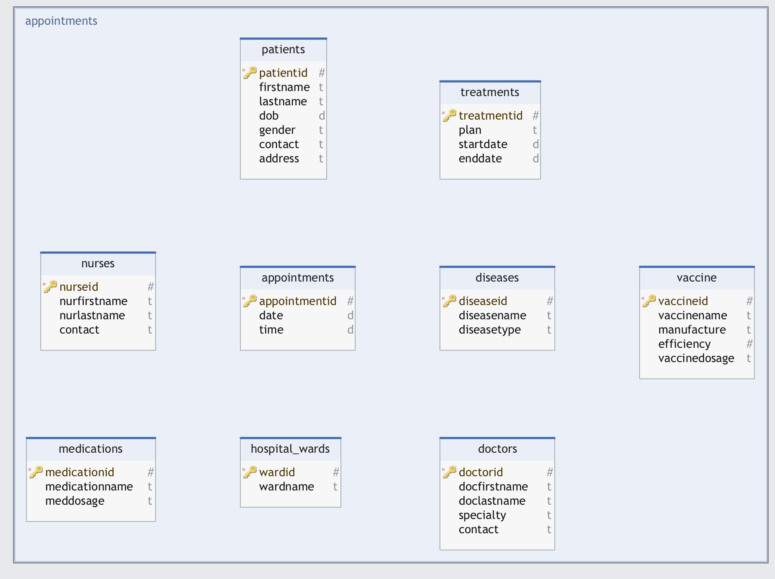

Slide 4
Relationships:
Patients-Diseases: Many-to-Many
Explanation: A patient can have multiple diseases, and a disease can affect multiple patients.
Patients-Vaccine: Many-to-Many
Explanation: A patient can receive multiple vaccines, and a vaccine can be administered to multiple patients.
Doctors-Treatments: One-to-Many
Explanation: This establishes a one-to-many relationship where each treatment is associated with one doctor, but a doctor can be associated with multiple treatments.
Diseases-Treatments: One-to-Many
Explanation: This establishes a one-to-many relationship where each treatment is associated with one disease, but a disease can be associated with multiple treatments.
Medications-Treatments: One-to-Many
Explanation: This establishes a one-to-many relationship where each treatment is associated with one medication, but a medication can be associated with multiple treatments.
Nurses-Treatments: One-to-Many
Explanation: This establishes a one-to-many relationship where each treatment is associated with one nurse, but a nurse can be associated with multiple treatments.
Patients-Hospital_Wards: One-to-Many
Explanation: This establishes a one-to-many relationship where each patient is assigned to one hospital ward, but a ward can have multiple patients.
Appointments: One-to-Many
Explanation: This establishes one-to-many relationships:
Each appointment is associated with one patient.
Each appointment is associated with one doctor.
Each appointment is associated with one treatment.

Slide 5
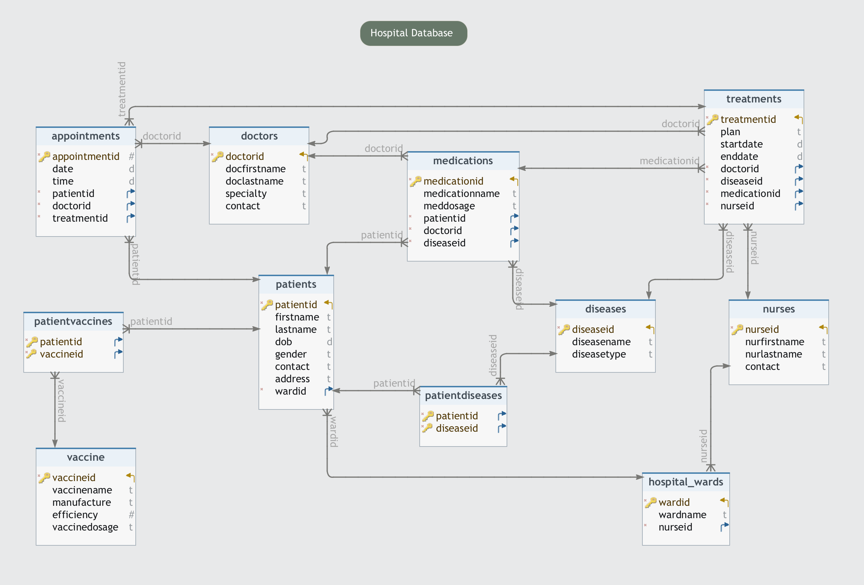

Slide 6
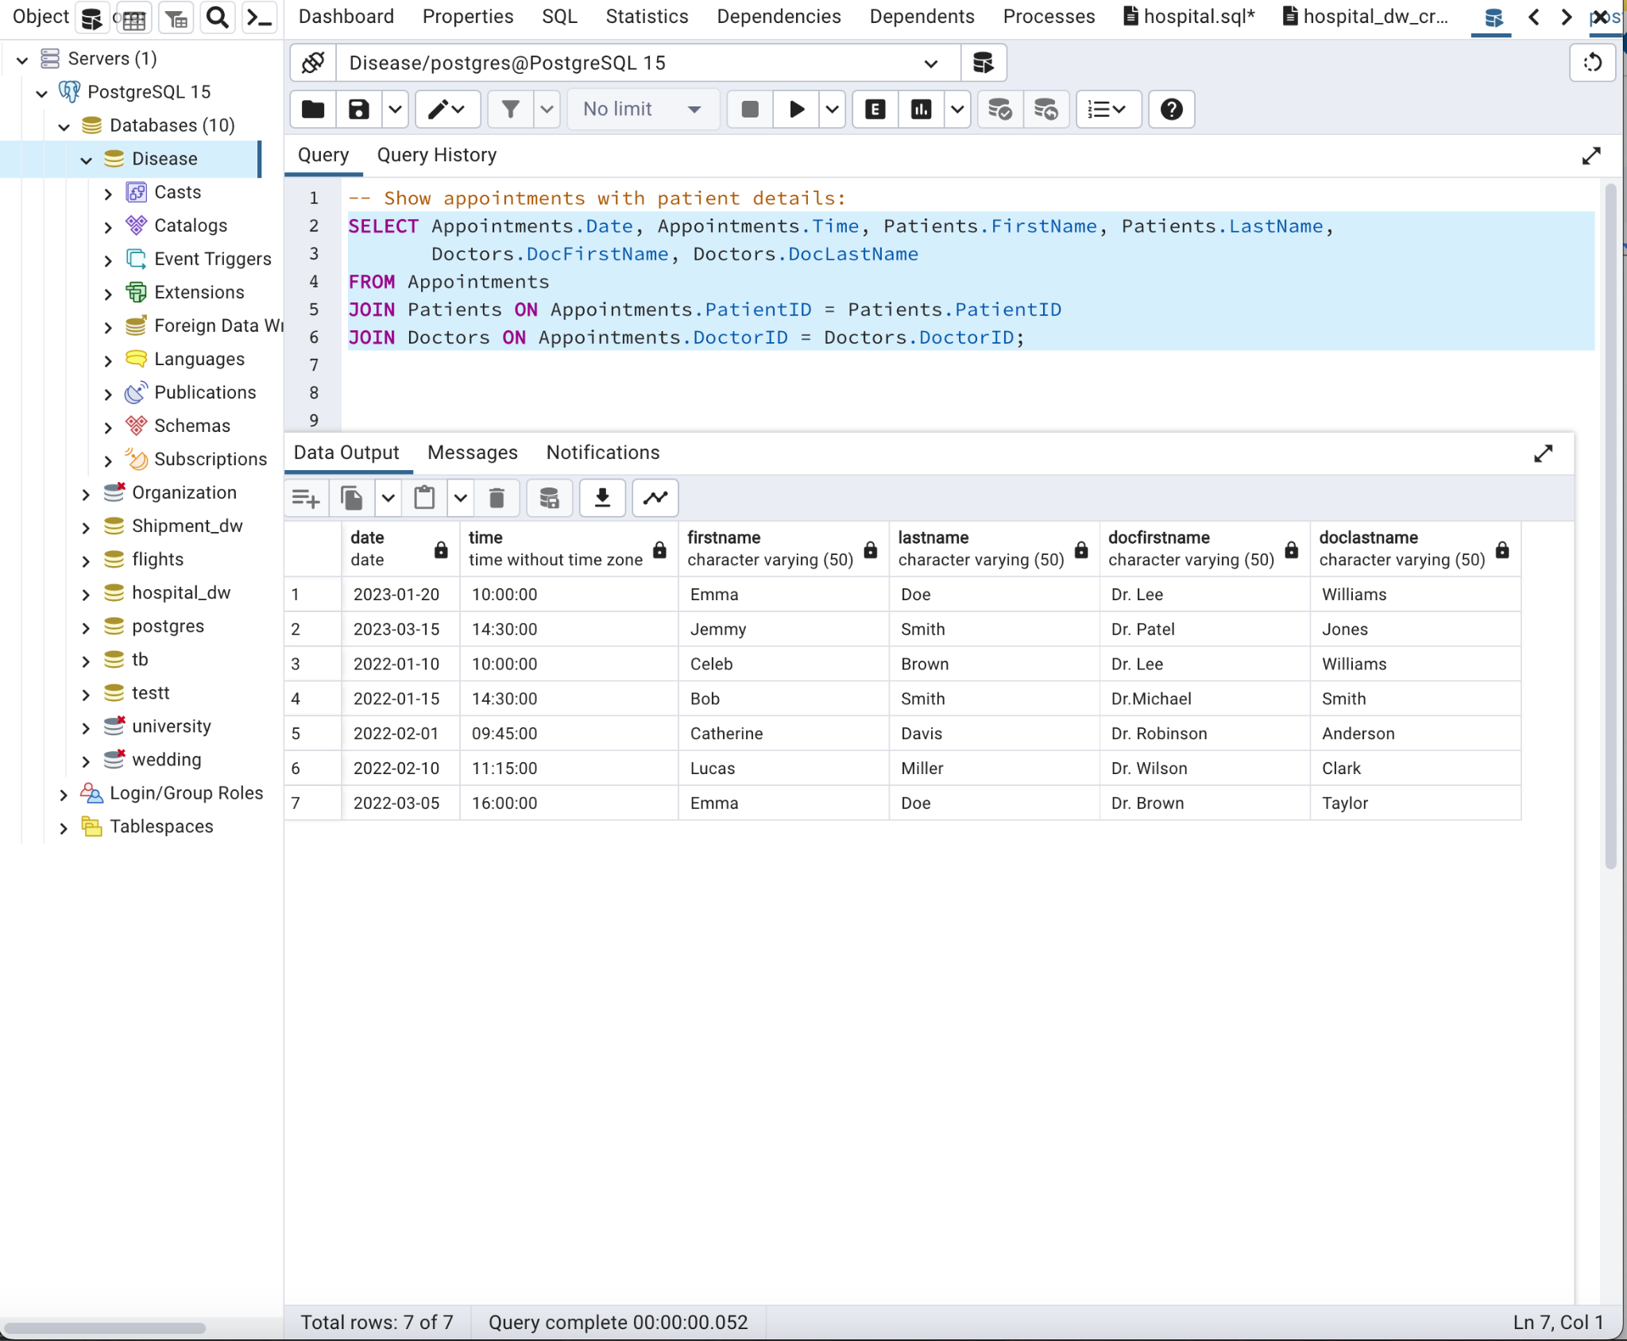
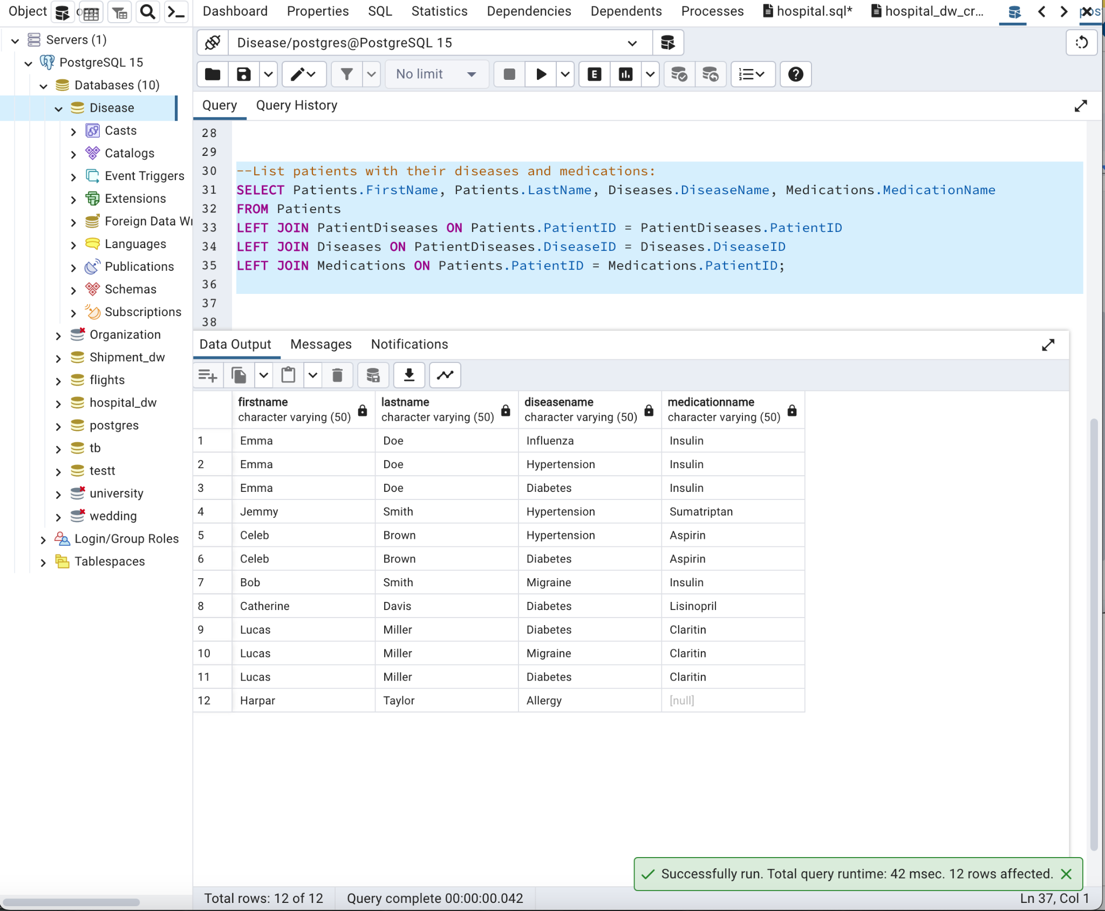
Operational Queries:
Queries
Show appointments with patient details:
List patients with their diseases and medications:

Slide 7
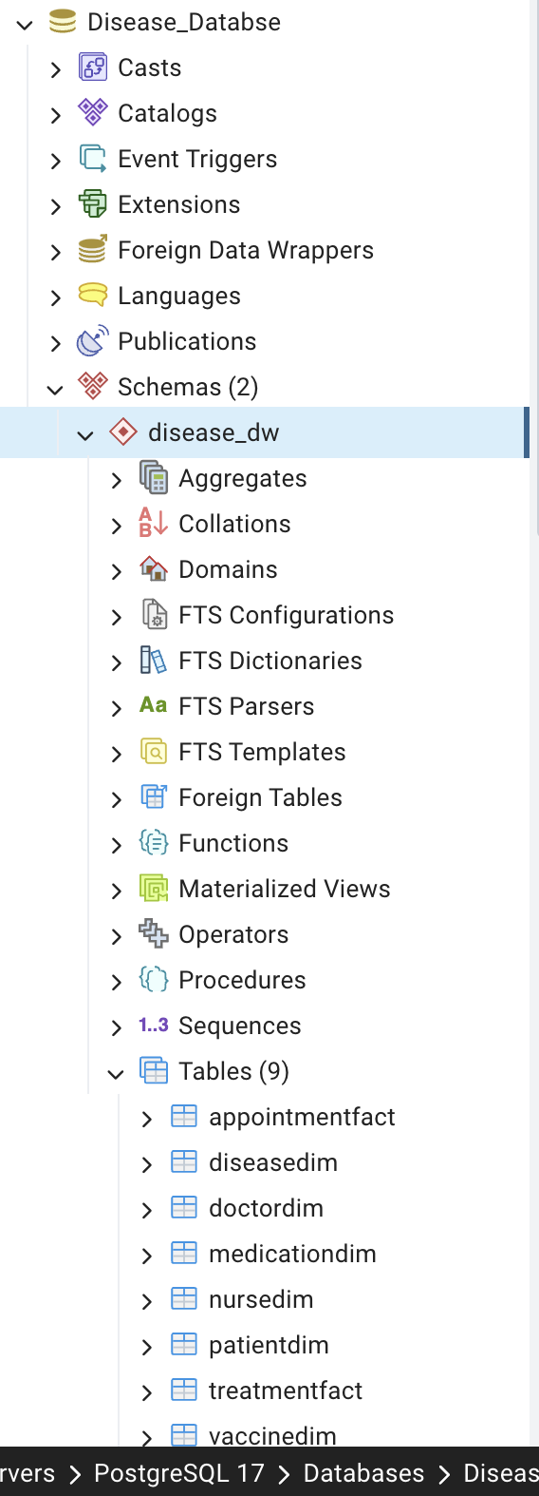
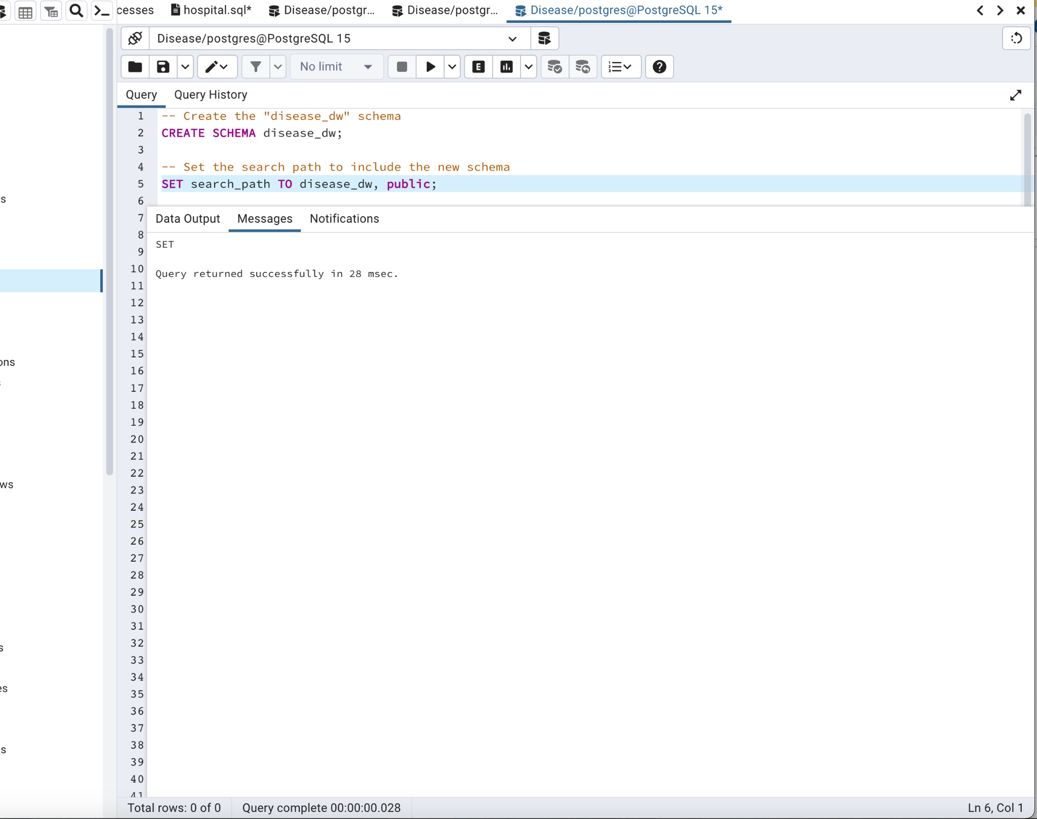
Designing a Dimensional Database and ETL Process:
For Hospital Database project, we've developed a sophisticated dimensional database alongside an efficient Extract, Transform, Load (ETL) process. This system is crucial for converting detailed transactional data into a format suitable for advanced analytics and reporting.
Dimensional Database Structure:
Star Schema Creation: We've established a star schema within the disease_dw schema to facilitate easy querying and reporting.

Slide 8
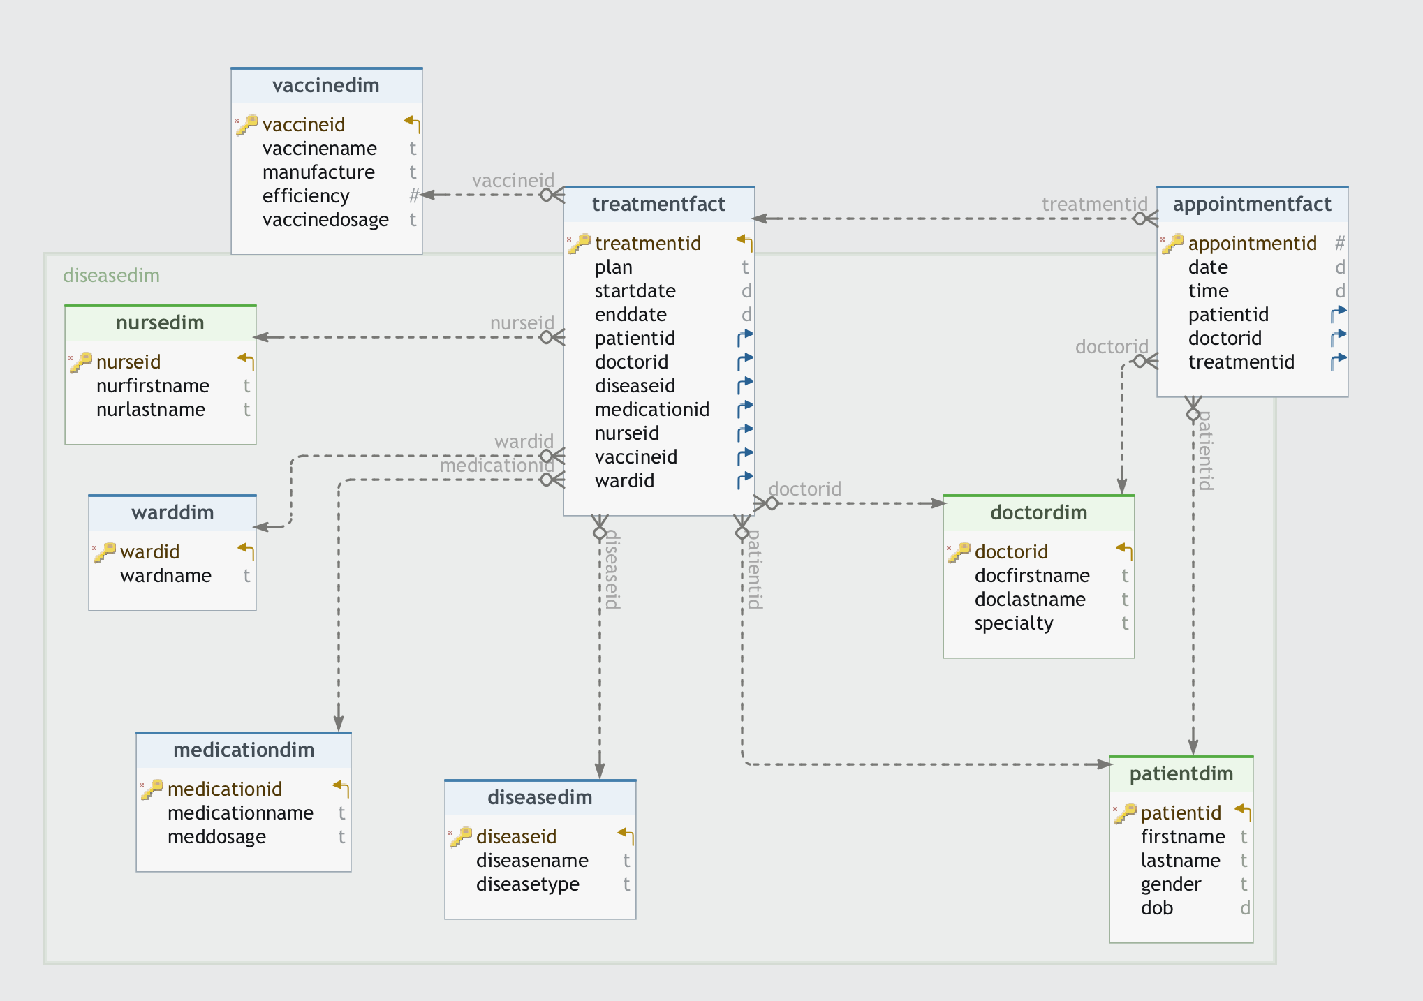
disease_dw Schema Dimensional Modeling

Slide 9
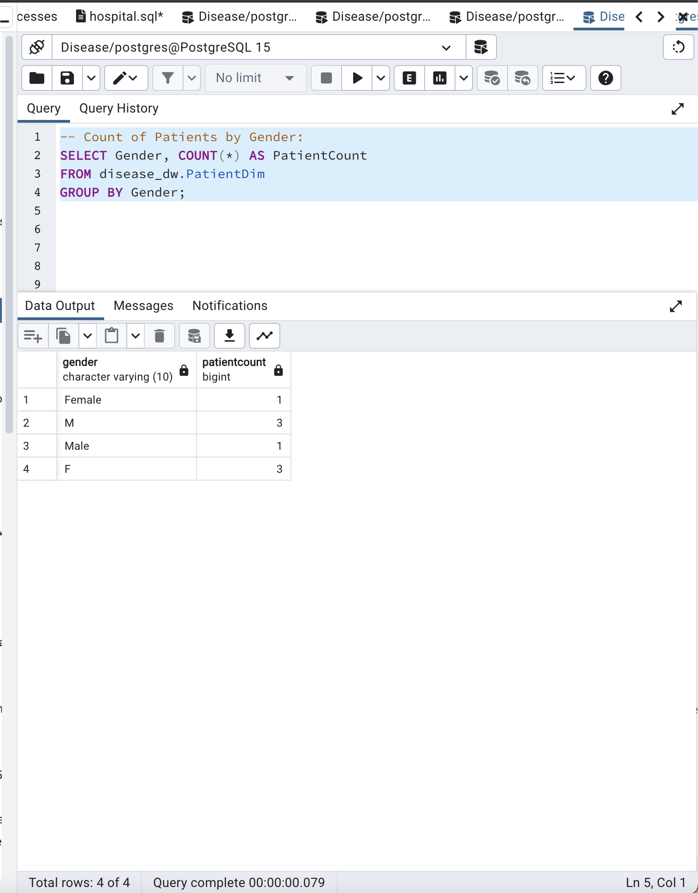
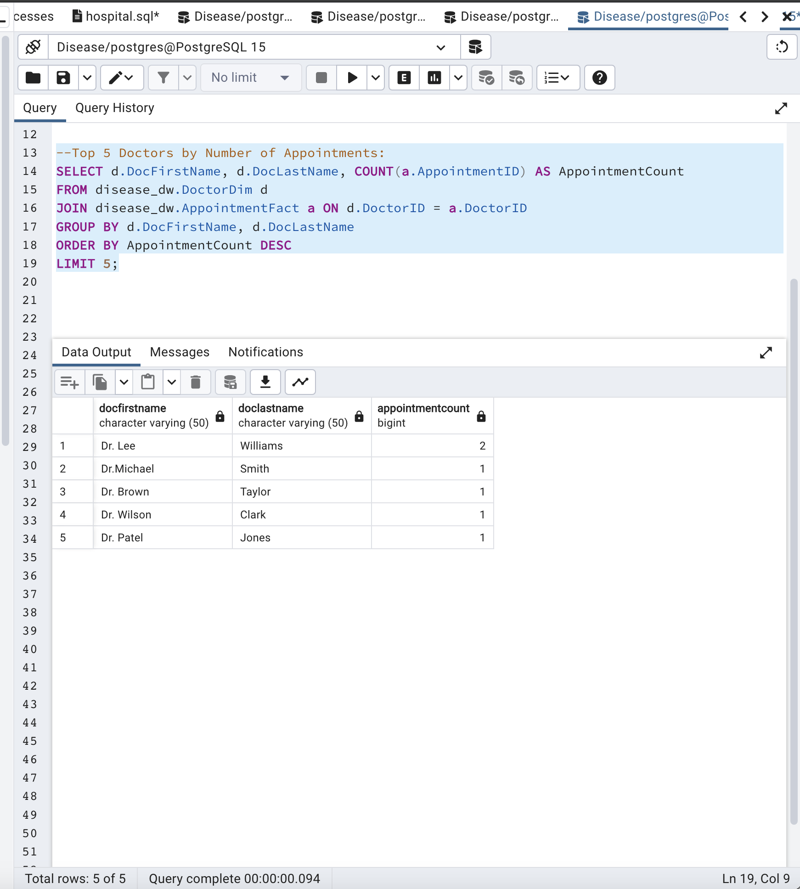
Queries:
How many patients by gender
Check Top 5 doctors by no.of appointments

Slide 10
NoSQL Database :
In a NoSQL database like MongoDB, data organization differs from traditional SQL databases, as it does not rely on tables and relationships.
MongoDB, being a document-oriented database, utilizes BSON documents, which are a binary representation of JSON documents.
For our Hospital database, instead of maintaining separate tables for Patients, Diseases, Doctors, and related entities, we can adopt a consolidated approach.
A single "Treatments" collection may be employed, wherein each treatment document encapsulates embedded documents representing associated patient, disease, medication, doctor, nurse, vaccine, and appointment details. This denormalized approach offers advantages such as expedited data retrieval by minimizing the necessity for intricate, join-intensive queries.
For the Hospital database, "Treatments" has a collection where each document represents a treatment event and includes embedded documents for associated entities.

Slide 11
"doctor": {
"first_name": "Dr. Smith",
"last_name": "Johnson",
"specialty": "Cardiology",
"contact": "987-654-3210"
},
"nurse": {
"first_name": "Mary",
"last_name": "Johnson",
"contact": "555-123-4567"
},
"vaccine": {
"vaccine_name": "COVID-19 Vaccine",
"manufacturer": "Pfizer"
},
Example:
{
"_id": ObjectId("5fe4eae0472a3b1d5c3e2536"),
"patient": {
"first_name": "John",
"last_name": "Doe",
"dob": ISODate("1990-05-15"),
"gender": "M",
"contact": "123-456-7890",
"address": "123 Main St"
},
"disease": {
"disease_name": "Flu",
"disease_type": "Viral"
},
"medication": {
"medication_name": "Ibuprofen"
},
"appointment": {
"appointment_time": ISODate("2023-01-10T10:00:00"),
"appointment_date": ISODate("2023-01-10")
}
}

Slide 12
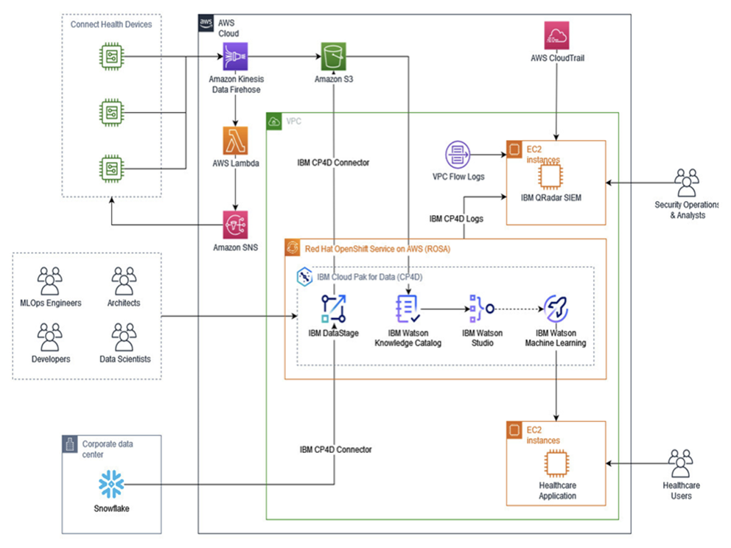
Data Management with AWS:
Resilience Features:
Multi-AZ Deployment
Disaster Recovery
Automated Backups
Amazon Route 53
Security Features:
Encryption
AWS Key Management Service (KMS)
IAM Roles
VPC Isolation
High Performance:
Amazon Aurora: With automated replication, interoperability with MySQL and PostgreSQL, and scalability, Amazon Aurora is a good option.
Performance Insights: To visualize database performance, pinpoint bottlenecks, and enhance query performance, enable RDS Performance Insights.
Amazon CloudWatch: To guarantee the general health and functionality of the system, use CloudWatch for real-time monitoring and alert setup for important metrics.

Slide 13
Snowflake
Snowflake is a cloud-based data warehousing platform that offers several advantages that can be beneficial for a hospital database.
Here are few advantages of Snowflake that could help in the context of a hospital database:
Separation of Storage and Compute
Elastic Scalability
Zero-Copy Cloning
Secure Data Sharing
Time-Travel and Data Versioning
Built-in Data Security and Compliance
Global Availability and Multi-Cloud Support
Performance Optimization and Query Pushdown
Schema-on-Read Approach

Slide 14

Thank you

